Slide 1

Bridge Engineering
Lecture 1 A
Planning of Bridges
Dr. Shahzad Rahman

Slide 2
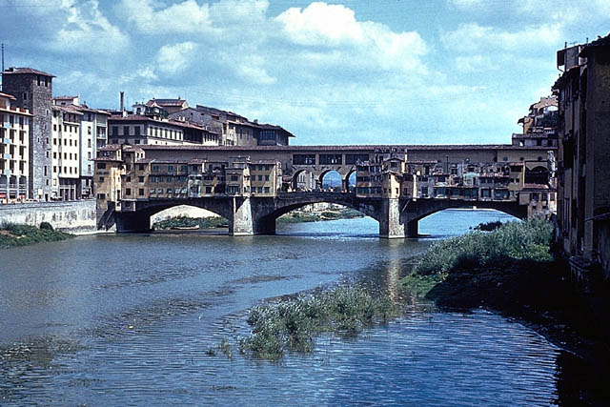
Bridge Planning
Traffic Studies
Hydrotechnical Studies
Geotechnical Studies
Environmental Considerations
Alternatives for Bridge Type
Economic Feasibility
Bridge Selection and Detailed Design

Slide 3
Traffic Studies
River
New Road Link
Existing Network
New Bridge
City Center

Slide 4
Traffic Studies
Traffic studies need to be carried out to ascertain the amount of traffic that will utilize the New or Widened Bridge
This is needed to determine Economic Feasibility of the Bridge
For this Services of a Transportation Planner and or Traffic Engineer are Required
Such Studies are done with help of Traffic Software such as TransCAD, EMME2 etc.

Slide 5
Traffic Studies
Traffic Studies should provide following information
  Traffic on Bridge immediately after opening
  Amount of traffic at various times during life of the Bridge
  Traffic Mix i.e. number of motorcars, buses, heavy trucks and other vehicles
  Effect of the new link on existing road network
  Predominant Origin and Destination of traffic that will use the Bridge
  Strategic importance of the new/improved Bridge

Slide 6
Hydrotechnical Studies
A thorough understanding of the river and river regime is crucial to planning of Bridge over a river
Hydrotechnical Studies should include:
Topographic Survey 2km upstream and 2km downstream for small rivers including Longitudinal section and X-sections
For big rivers 5kms U/S and 2kms D/S should be surveyed
Navigational Requirements

Slide 7
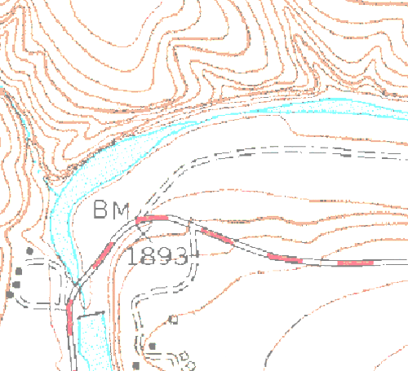
Hydrotechnical Studies
Scale of the topographic map
  1:2000 for small rivers
  1:5000 for large rivers
The High Flood Levels and the Observed Flood Level should be indicated map
Sufficient Number of x-sections should be taken and HFL and OFL marked on them
River Bed surveying would require soundings

Slide 8
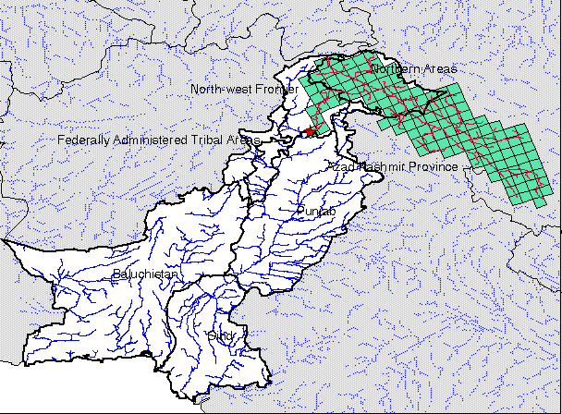
Hydrotechnical Studies
Catchment Area Map
Scale recommended
  1:50,000 or
  1:25,000
Map can be made using GT Sheets available from Survey of Pakistan
All Reservoirs, Rain Gauges Stns., River Gauge Stns., should be marked on map
Catchment of River Indus

Slide 9
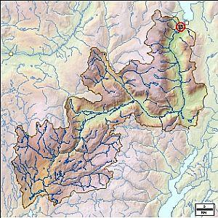
Hydrotechnical Studies
River Catchment Area

Slide 10
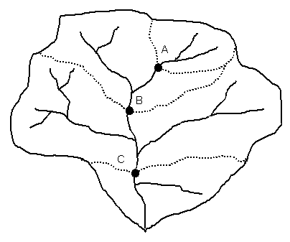
Hydrotechnical Studies
River Catchment Boundaries with Tributaries

Slide 11
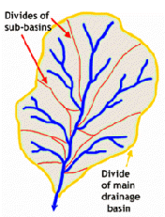
Hydrotechnical Studies
River Catchment Boundaries with Sub-Basin Boundaries

Slide 12
Hydrological Data
Following Hydrological Data should be collected:
Rainfall Data from Rain Gauge Stations in the Catchment Area
Isohyetal Map of the Catchment Area showing contours of Annual Rainfall
Hydrographs of Floods at River Gauge Stations
Flow Velocities
Sediment Load in River Flow during floods

Slide 13
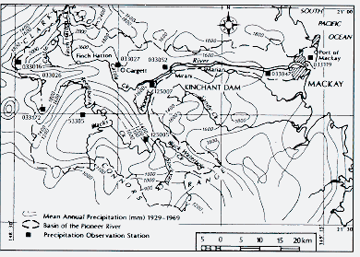
Hydrologic Data
Example of an ISOHYETAL MAP

Slide 14
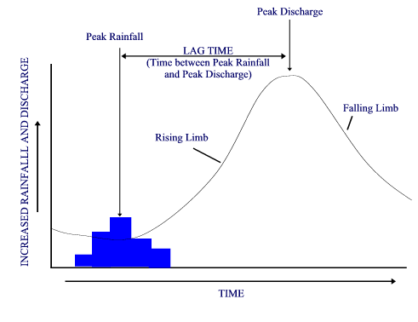
Hydrologic Data
Example of River Hydrograph

Slide 15
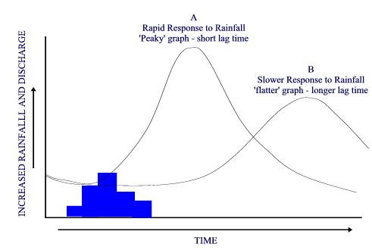
Hydrologic Data
Example of a River Hydrograph

Slide 16
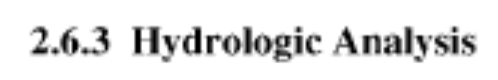
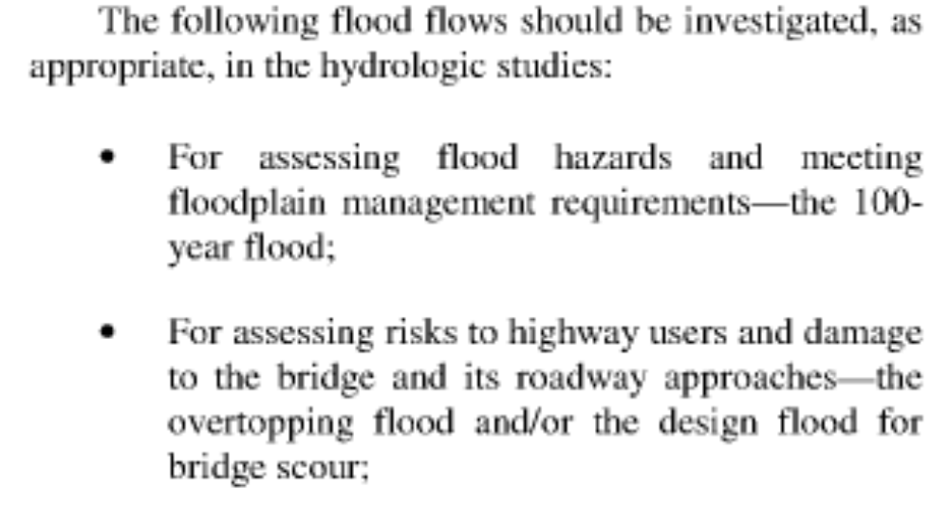
Design Flood Levels
AASHTO Gives Following Guidelines for Estimating Design Flood Levels

Slide 17
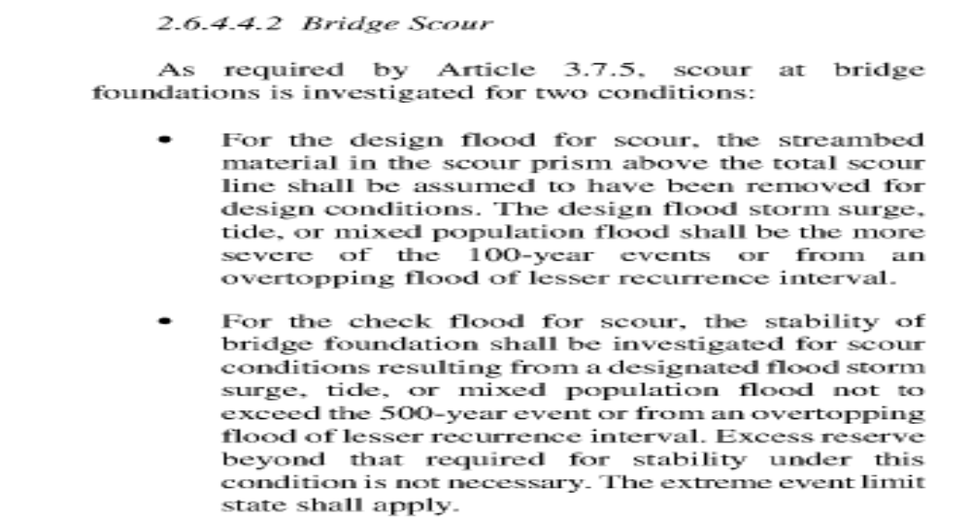
Design Flood Levels
AASHTO Gives Following Guidelines for Estimating Design Flood Levels

Slide 18
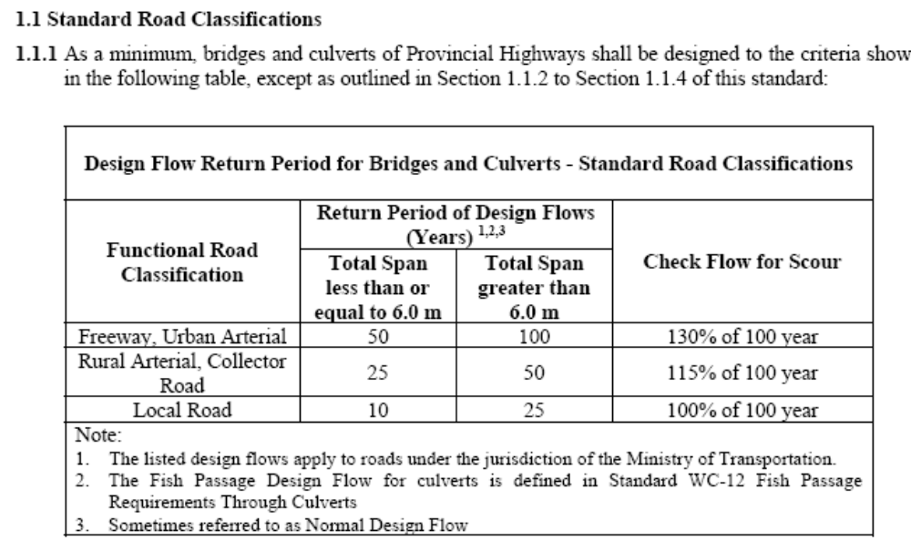
Design Flood Levels
CANADIAN MINISTRY OF TRANSPORTATION
Gives Following Guidelines for Estimating Design Flood Levels

Slide 19

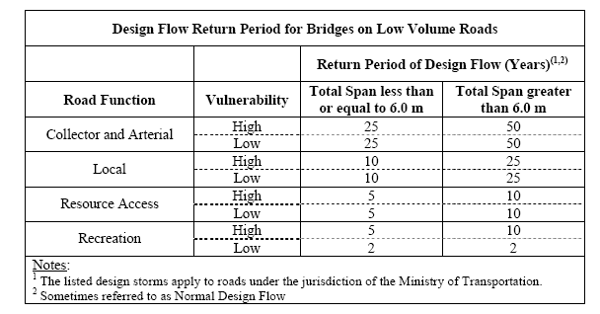
Design Flood Levels
CANADIAN MINISTRY OF TRANSPORTATION
Gives Following Guidelines for Estimating Design Flood Levels

Slide 20
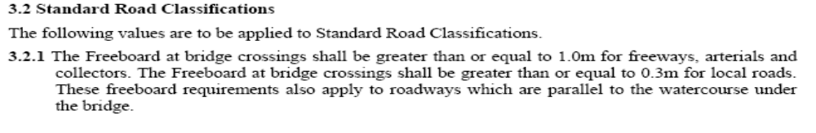
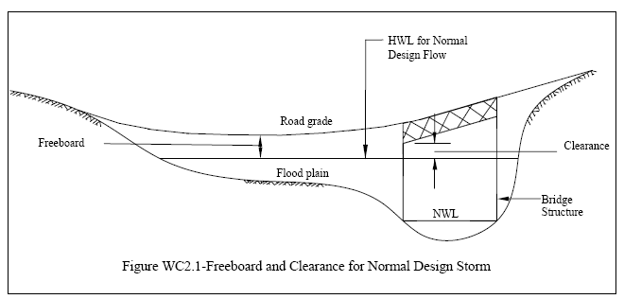
Design Flood Levels
FREEBOARD REQUIREMENTS
CANADIAN MINISTRY OF TRANSPORTATION
Gives Following Guidelines for Estimating Freeboard Requirements

Slide 21
Estimating Design Flood
Flood Peak Discharge at Stream or River Location Depends upon:
Catchment Area Characteristics
  Size and shape of catchment area
  Nature of catchment soil and vegetation
  Elevation differences in catchment and between catchment and bridge site location
Rainfall Climatic Characteristics
  Rainfall intensity duration and its spatial distribution
Stream/River Characteristics
  Slope of the river
  Baseline flow in the river
  River Regulation Facilities/ Dams, Barrages on the river

Slide 22
Methods of Estimating Design Flood
Empirical Methods
Flood Frequency Analysis
Rational Method

Slide 23
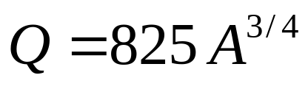
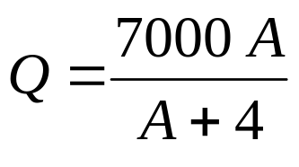
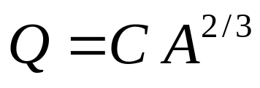
Empirical Methods of Peak Flood Estimation
Empirical Formulae have been determined that relate Catchment Area and other weather or river parameters to Peak Flood Discharge
Popular Formulae for Indo-Pak are:
  Dickens Formula
Q = Discharge in Cusecs
A = Catchment Area in Sq. Miles
  Inglis Formula
  Ryve’s Formula
C = 450 for areas within 15 miles off coast
560 between 15 – 100 miles off coast

Slide 24
Flood Frequency Analysis Method
Usable at gauged sites where river discharge data is available for sufficient time in past
Following Methods are commonly used
  Normal Distribution Method
  Log-Normal Distribution
  Log-Plot Graphical Method

Slide 25
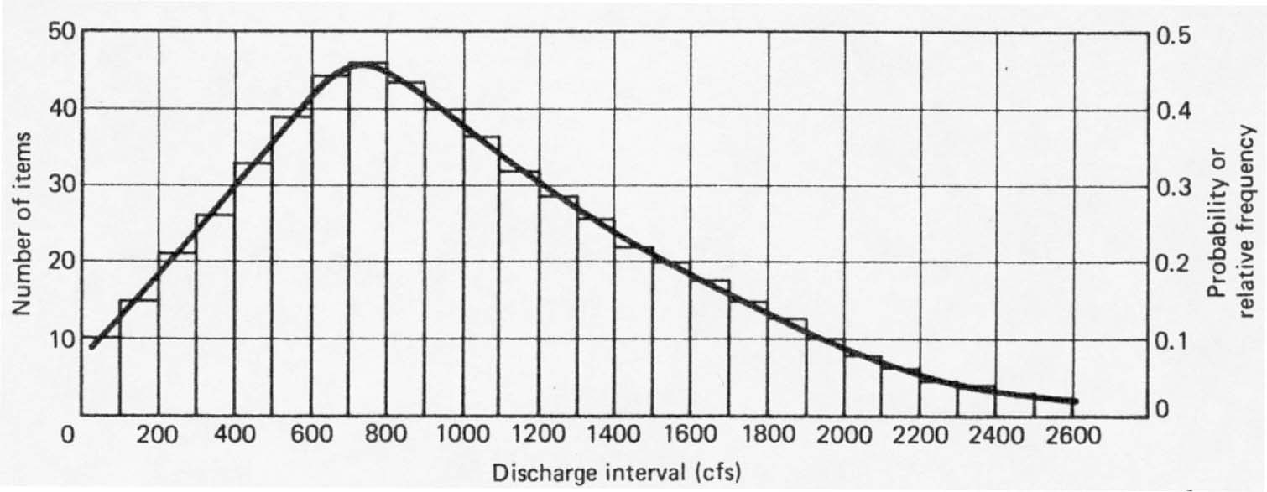
Flood Frequency Analysis Method
Normal Distribution Method
  Based on Assumption that events follow the shape of Standard Normal Distribution Curve

Slide 26
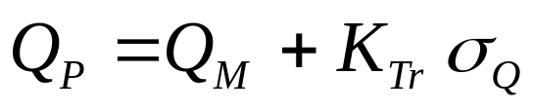
Normal Distribution Method
probability
Q
Q_{P} = Discharge Associated with Probability of Occurrence P
QM = Mean Discharge over the data set
σQ = Standard Deviation of the Discharge data set
KTr = Frequency factor corresponding to Probability of Occurrence P

Slide 27
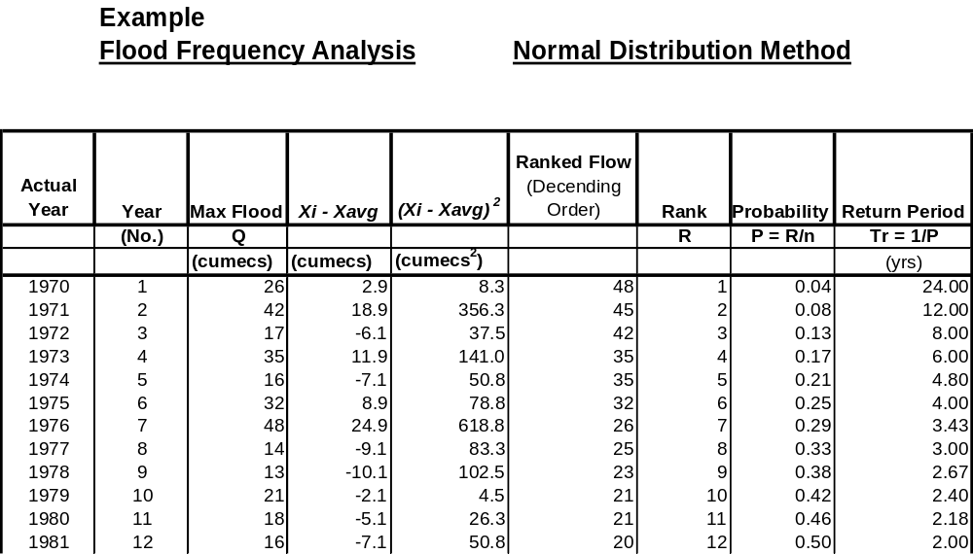
Example of Peak Flood Estimation Flood

Slide 28
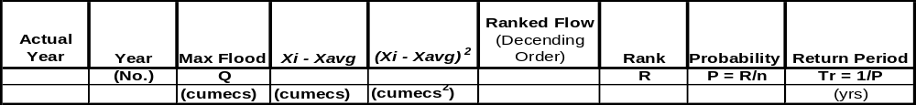
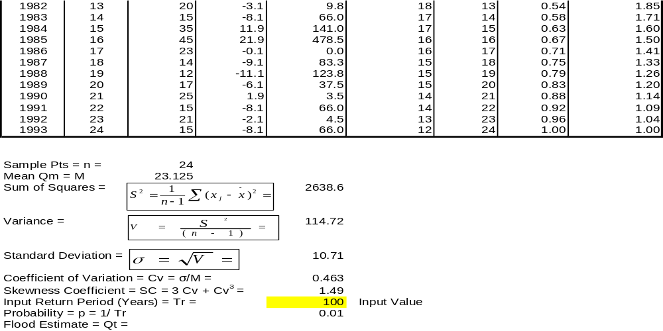
Example of Peak Flood Estimation Flood

Slide 29
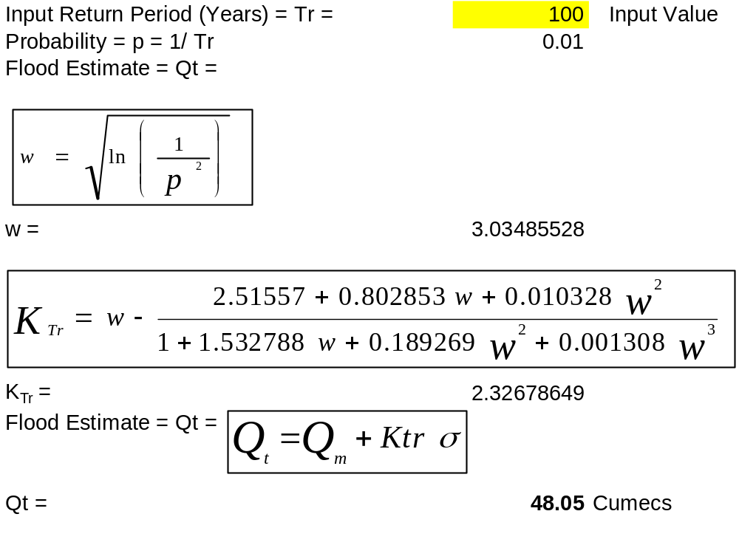
Example of Peak Flood Estimation Flood

Slide 30

Log-Normal Distribution Method
Yields better Results
Compared to Normal
Distribution Method
probability
Log Q or Ln Q
lnQ_{P} = Log of Discharge Associated with Probability of Occurrence P
lnQ_{M} = Mean of Log Discharge over the data set
σ_{lnQ} = Standard Deviation of the Log of Discharge data set
K_{Tr} = Frequency factor corresponding to Probability of Occurrence P
Q_{P} = Antilog (ln Q_{P}) = Discharge Associated with Probability of Occurrence P

Slide 31
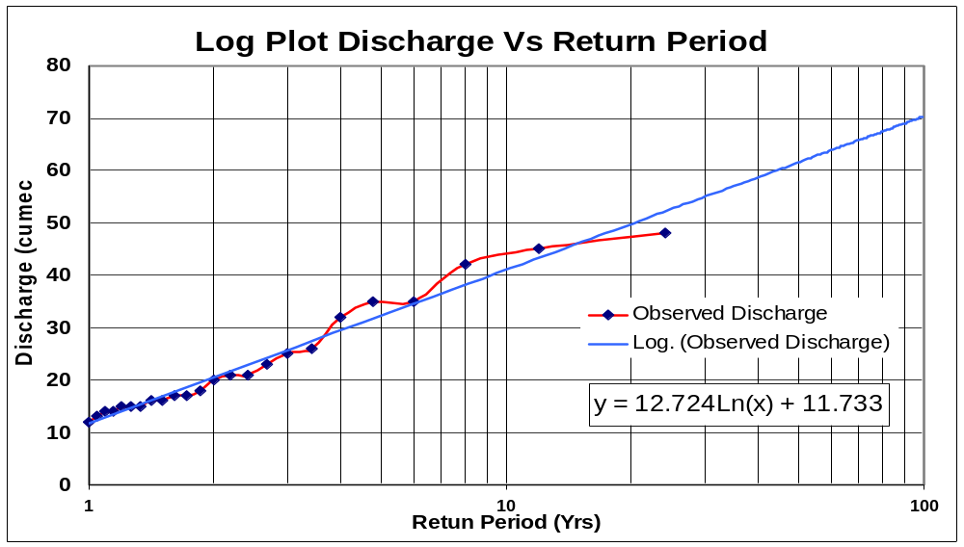
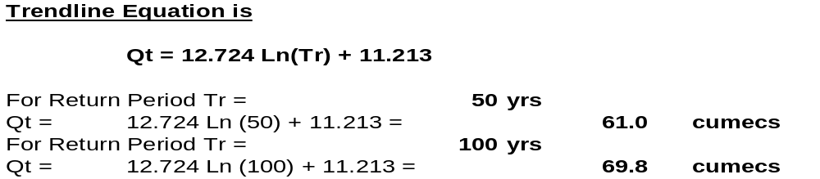
Example of Peak Flood Estimation Flood
Log-Plot Method

Slide 32
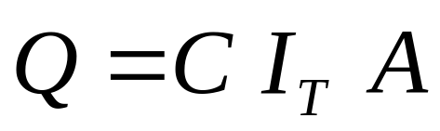
Rational Method of Peak Flood Estimation
Attempts to give estimate of Design Discharge taking into account:
  The Catchment Characteristics
  Rainfall Intensity
  Discharge Characteristics of the Catchment
Q = Design Discharge
I_{T} = Average rainfall intensity (in/hr) for some recurrence interval, T
during that period of time equal to Tc.
Tc = Time of Concentration
A = Area of the catchment in Sq. miles
C = Runoff coefficient; fraction of runoff, expressed as a
dimensionless decimal fraction, that appears as surface runoff
from the contributing drainage area.

Slide 33
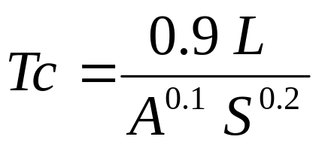
Rational Method of Peak Flood Estimation
Time of Concentration can be estimated using Barnsby Williams Formula which is widely used by US Highway Engineers
L = Length of Stream in Miles
A = Area of the catchment in Sq. miles
S = Average grade from source to site in percent

Slide 34
Rational Formula – Runoff Coefficient
Area Characteristic | Run-off Coefficient C
Steep Bare Rock | 0.90
Steep Rock with Woods | 0.80
Plateau with light cover | 0.70
Densely built-up areas | 0.90 – 0.70
Residential areas | 0.70 – 0.50
Stiff Clayey soils | 0.50
Loam | 0.40 – 0.30
Suburbs with gardens | 0.30
Sandy soils | 0.1 – 0.20
Jungle area | 0.10 – 0.25
Parks, Lawns, Fields | 0.25 - 0.50

Slide 35
Geotechnical Studies
Geotechnical Studies should provide the following Information:
The types of Rocks, Dips, Faults and Fissures
Subsoil Ground Water Level, Quality, Artesian Conditions if any
Location and extent of soft layers
Identification of hard bearing strata
Physical properties of soil layers

Slide 36
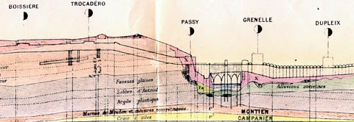
Geotechnical Studies
Example Geological Profile:
Cross section of the soil on the route of the Paris
The diagram above shows the crossing over the Seine via the Bir Hakeim bridge and the limestone quarries under Trocadéro

Slide 37
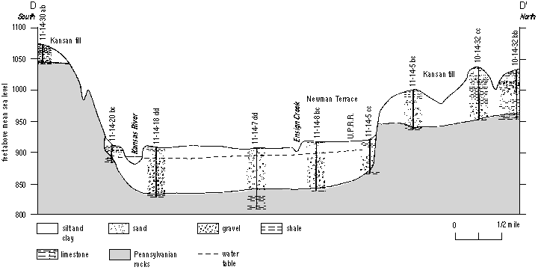
Geotechnical Studies
Example: Cross section of the Kansas River, west of Silver Lake, Kansas
Typical Borehole

Slide 38
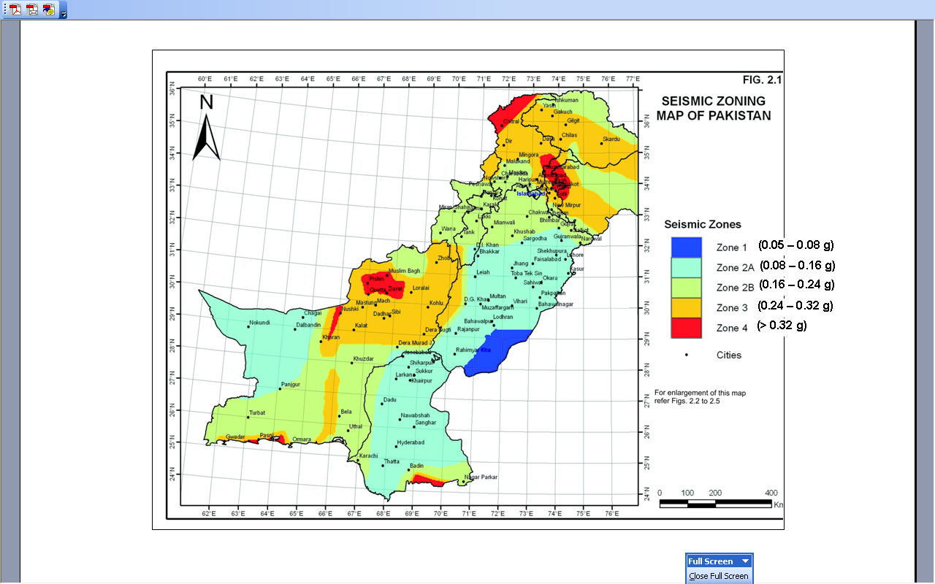
Seismic Considerations
Source: Building Code of Pakistan

Slide 39
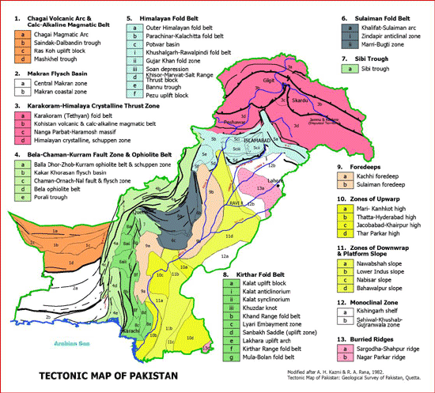
Tectonic Setting of the Bridge Site
Source: Geological Survey of Pakistan

Slide 40
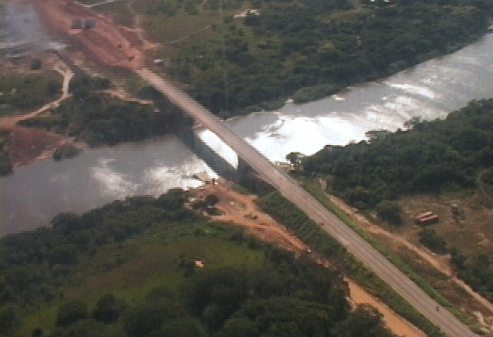
Environmental Considerations
Impact on Following Features of Environment need to considered:
  River Ecology which includes:
    Marine Life
    Wildlife along river banks
    Riverbed
    Flora and fauna along river banks
  Impact upon dwellings along the river if any
  Impact upon urban environment if the bridge in an urban area
  Possible impact upon archeological sites in vicinity

Slide 41
Bridge Economic Feasibility
Economic Analysis is Required at Feasibility Stage to justify expenditure of public or private funds
A Bridge is the most expensive part of a road transportation network
Types of Economic Analyses
  Cost Benefit Ratio Analysis
  Internal Rate of Return (IRR) Analysis

Slide 42
Bridge Economic Analysis/
Life Cycle Cost Analysis (LCCA)
Costs Stream
Benefits Stream
Time
Construction Stage
Project Start Date
Project Life End Date
Salvage Value
Project Life

Slide 43
Project Cost Benefit Analysis
The objective of LCCA is to
  Estimate the costs associated with the Project during Construction an its service life. These include routine maintenance costs + Major Rehab Costs
  Estimate the Benefits that will accrue from the Project including time savings to road users, benefits to business activities etc.
  Bring down the costs and benefits to a common reference pt. in time i.e. just prior to start of project (decision making time)
  Facilitate decision making about economic feasibility by calculating quantifiable yardsticks such as Benefit to Cost Ratio (BCR) and Internal Rate of Return (IRR)
Note: Salvage Value may be taken as a Benefit
This includes cost of the Right-of-Way and substructure

Slide 44
What is Life Cycle Cost?
An economic analysis procedure that uses engineering inputs
Compares competing alternatives considering all significant costs
Expresses results in equivalent dollars (present worth)

Slide 45
Time Period of Analysis
Normally equal for all alternatives
Should include at least one major rehabilitation
Needed to capture the true economic benefit of each alternative
Bridge design today is based on a probabilistic model of 100 years

Slide 46
Bridge Economic Analysis/
Life Cycle Cost Analysis (LCCA)
Costs Stream
Benefits Stream
Construction Stage
Time
Project Start Date
Project Life End Date
Problem:
Salvage Value
Project Life
Costs and Benefits Change over the life of the Project
Amount of Money/Benefit accrued some time in future is worth less in terms of Today’s money
Same is the case with the benefits accrued over time
The Problem now is as to How to find the Worth of a Financial Amount in Future in terms of Today’s Money
This is accomplished by using the instrument of “DISCOUNT RATE”

Slide 47

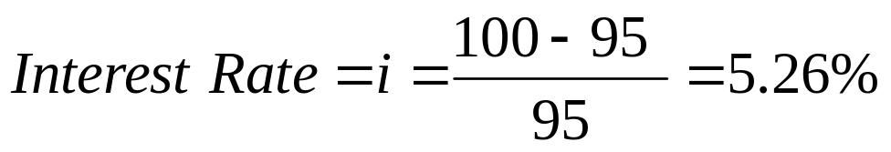

Bridge Economic Analysis/
Life Cycle Cost Analysis (LCCA)
DISCOUNT RATE:
The annual effective discount rate is the annual interest divided by the capital including that interest, which is the interest rate divided by 100% plus the interest rate. It is the annual discount factor to be applied to the future cash flow, to find the discount, subtracted from a future value to find the value one year earlier.
For example, suppose there is an investment made of $95 and pays $100 in a year's time. The discount rate according the given definition is:
Interest Rate is calculated as $ 95 as Base
Interest Rate and Discount Rate are Related as Follows

Slide 48
Discount Rate
Thus Discount Rate is that rate which can be used to obtain the Present Value of Money that is spent or collected in future
Cost/ Benefit Projected
Backward
Costs Stream
Cn
Co
Year n
Benefits Stream
Time
Project Start Date
Bo
Bn
Project Life
Net Present value of Cost incurred = Co = (1 - d)^{n} Cn
In Year n
Net Present value of Cost incurred = Bo = (1 - d)^{n} Bn
In Year n

Slide 49
What Discount Rate to Use?
A first estimate of appropriate Discount rate can be made as follows:
Estimate of
Discount Rate = Federal Bank Lending Rate – Average Long-term Inflation Rate
Note: By subtracting the Inflation Rate in arriving at a Discount Rate the
effect of Inflation can be removed from consideration during
Economic Analysis
The Discount Rate after subtracting the Inflation Rate is also
Referred to as the “Real Discount Rate”
Govt. of Pakistan uses a Discount Rate of 6-7% for
economic analysis
Asian Development Bank uses a Discount rate of 12% for
evaluation of projects
Discount Rate is less than the Real interest Rate as Governments
do not take a purely commercial view of an infrastructure project

Slide 50
Cost Considerations
Present Worth
Salvage Costs
Initial Cost
Rehabilitation Cost
Maintenance and
Inspection
Cost
Costs
Years
Salvage Value

Slide 51
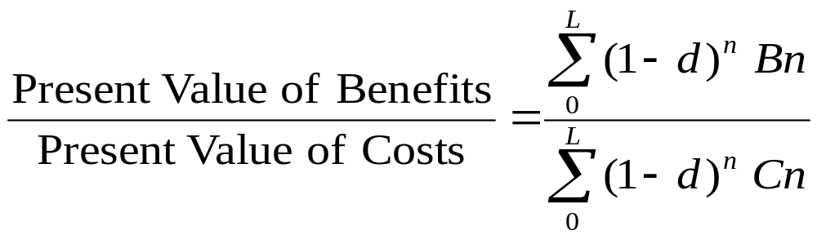
Cost Benefit Ratio
Formula for Cost
Benefit Ratio
Benefit To Cost Ratio =
Where L = Life Span of the Project in Years
d = Discount Rate
Bn = Benefit in year n
Cn = Cost incurred in year n

Slide 52
Net Present Worth/ Value
Net Present Worth/ Value = NPW or NPV is defined as follows:
NPW = NPV = Present Value of Benefits – Present Value of Costs
Note: If a Number of alternatives are being compared, the alternative
that has the highest Net Present Worth is the preferable one and
will also have the higher Benefit to Cost Ratio

Slide 53
What is Internal Rate of Return (IRR)
IRR may be defined as that Discount Rate at which the Benefit to Cost Ratio (BCR) of a Project becomes exactly 1.0
It is a better measure of economic viability of a project compared to Benefit to Cost Ratio
It is a good indicator of how much inflation increase and interest rate hike a project can tolerate and still be viable

Slide 54
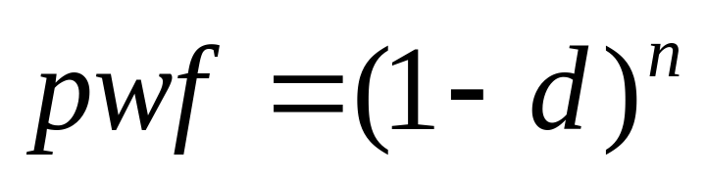
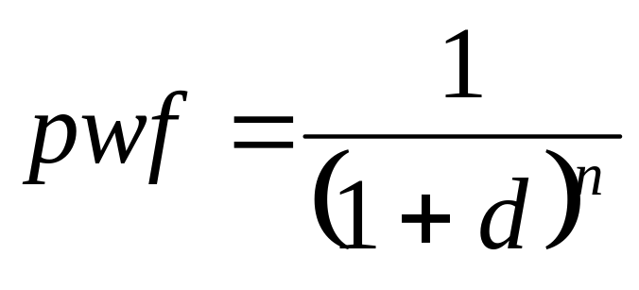
Present Worth Factor
pwf = Present Worth Factor for discount rate d and year n
d = Discount rate
n = Number of year when the cost/ benefit will occur
Alternate Formula (Usually Adopted)

Slide 55
Present Worth Analysis
Discounts all future costs and benefits to the present:
t=L
PW = FC + Σ pwf [MC+IC+FRC+UC] + pwf [S]
t=0
PW = Present Worth/ Value of the Project
FC = First (Initial) Cost
t = Time Period of Analysis (ranges from 0 → L)
MC = Maintenance Costs
IC = Inspection Costs
FRC = Future Rehabilitation Costs
UC = Users Costs
S = Salvage Values or Costs
pwf = Present Worth Factor

Slide 56
Time Period of Analysis
Normally equal for all alternatives
Should include at least one major rehabilitation
  Needed to capture the true economic benefit of each alternative
Bridge design today is based on a probabilistic model of 100 years

Slide 57
Maintenance Costs
Annual cost associated with the upkeep of the structure
Information is difficult to obtain for a given project
Cost varies on the basis of size of the structure (sqft)
Best Guess Values
  Frequency - Annual
  Concrete 0.05 % of Initial Cost
  Structural Steel 0.05 % of Initial Cost

Slide 58
Inspection Costs
Should be taken for all alternatives preferably every two years
Cost varies on the basis of size of the structure (sqft) and by construction material
Best Guess Values
  Frequency - Biannual
  Concrete 0.15 % of Initial Cost
  Structural Steel 0.20 % of Initial Cost

Slide 59
Future Painting Costs
Only applies to structural steel structures but excludes weathering steel
Should occur every 20 years
Cost varies on the basis of size of the structure (sqft)
Best Guess Values
  Frequency – every 20 years
  Concrete 0.0 % of Initial Cost
  Structural Steel 7.0 % of Initial Cost

Slide 60
Future Rehabilitation Costs
The frequency is not only a function of time but also the growing traffic volume and the structural beam system
Cost varies on the basis of size of the structure (sqft) and structural beam system
Best Guess Values
  Frequency
    First occurrence – Concrete 40 years
    First occurrence – Structural Steel 35 years
    Annual traffic growth rate .75 % (shortens rehab cycles)
  Concrete 20.0 % of Initial Cost
  Structural Steel 22.0 % of Initial Cost

Slide 61
Salvage Value/Costs
Occurs once at end of life of structure
Difference between
  Removal cost
  Salvage value
Best Guess Values
  Removal cost 10 % of Initial Cost
  Salvage Value – Concrete - 0 % of Initial Cost
  Salvage Value – Structural Steel - 2 % of Initial Cost

Slide 62
Benefits from a Bridge
Monetizable Benefits
Time savings to road users
Growth in economic activity
Saving of Vehicular wear and tear
Reduction of accidents if applicable
Other Non-Monetizable Benefits
Strategic Benefits

Slide 63
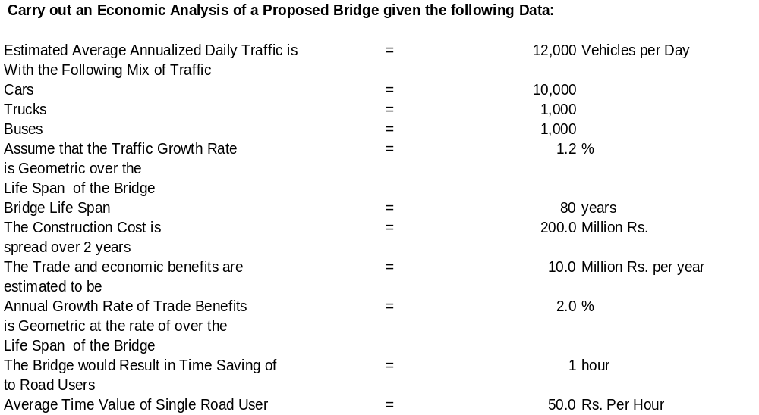
Example of Economic Analysis

Slide 64
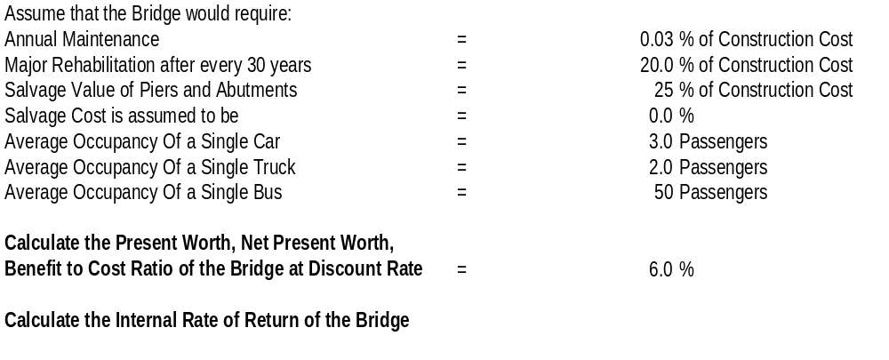
Example of Economic Analysis

Slide 65
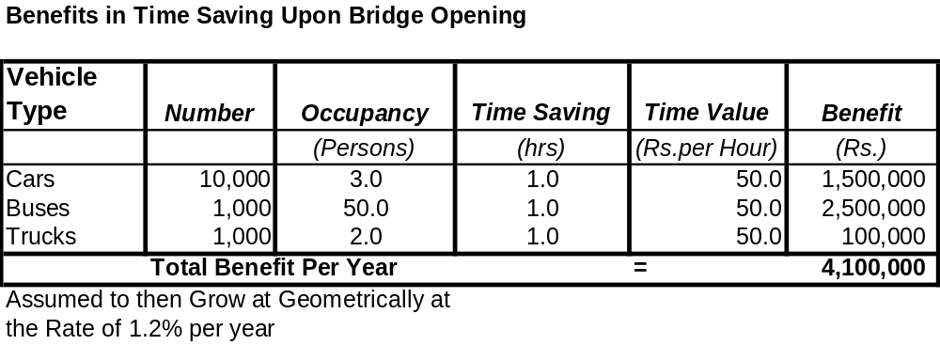
Example of Economic Analysis

Slide 66
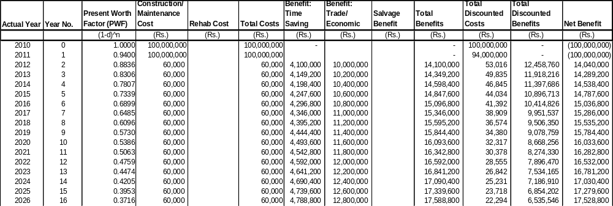
Example of Economic Analysis

Slide 67
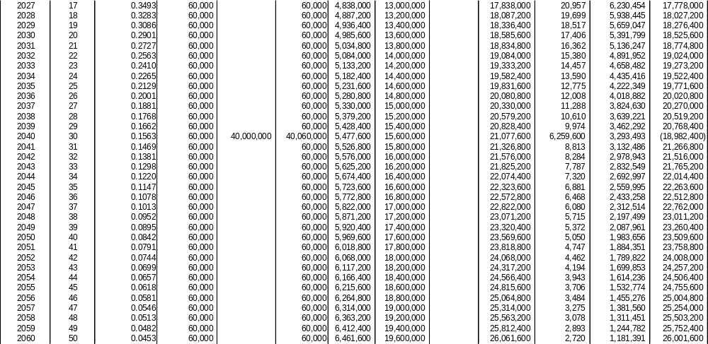
Example of Economic Analysis

Slide 68
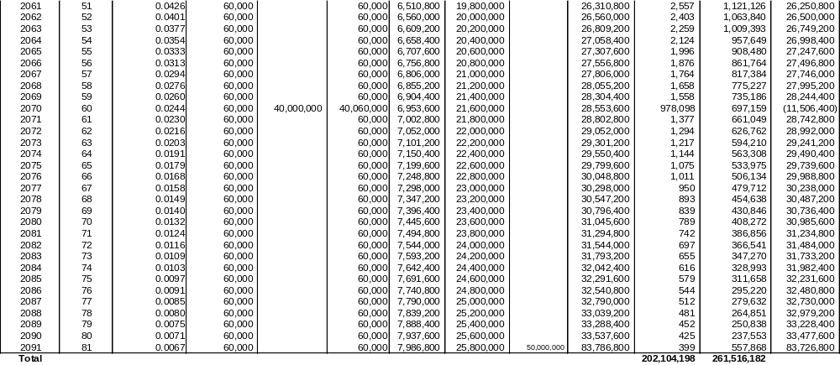
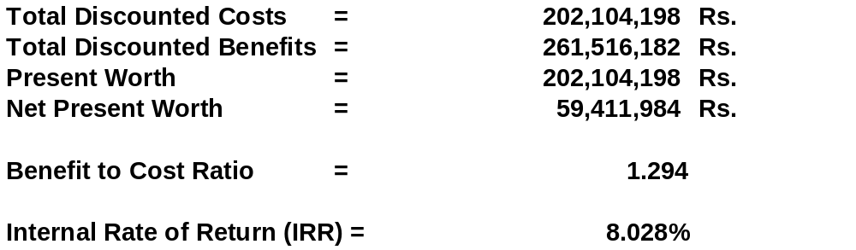
Example of Economic Analysis

